Slide 1
ESC Clermont Business School
https://www.youtube.com/watch?v=3oto0FPucSc

Slide 2
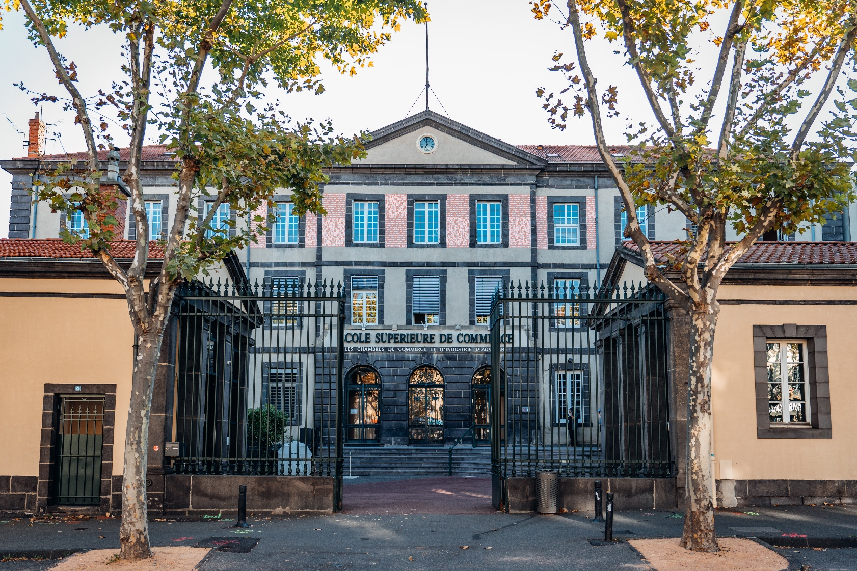
Studies at the ESC Clermont BS

Slide 3





Founded in 1919
Network of
14 000 Alumni in 109 countries
Network of more than 200
partner companies
2000+ students
3
International Accreditations
3
campuses abroad (China – Morocco)
120+
International Partners
15 000 m2 (and extension the premises in progress)
Member of the Conférence des Grandes Ecoles
35%
of International
Students
(63 nationalities)
50 Permanent professors & about 200 affiliated professors
About 10 Student associations
1 incubator launching entrepreneurial projects
17/10/2024
3

Slide 4




ESC Clermont Business School
Private Business School offering both undergraduate and graduate programs in Management and Business
Founded in 1919
Member of the Conference des Grandes Ecoles
AACSB Accredited since 2005
EFMD accredited Bachelor program since 2019
AMBA accredited Master program since 2020
Programs recognized by the French Ministry of Higher Education
Master Grande Ecole: Classified in the Top70 FT
Information about rankings

Slide 5

Geographical Situation
The City of Clermont
Studying in France

Slide 6



Geographical situation
Our School is located in the Auvergne Rhône Alpes Region
In the Puy-de-Dôme Department
ESC Clermont is located in Clermont-Ferrand, in the heart of France. Three advantages :
Distance : Central location Proximity to major cities : Paris 3h30, Marseille 4h, Lyon 1h30
Cost of living: One of the cities with the most affordable cost of living
Student Life : Regularly ranked among the best student cities in France (15% of students)

Slide 7


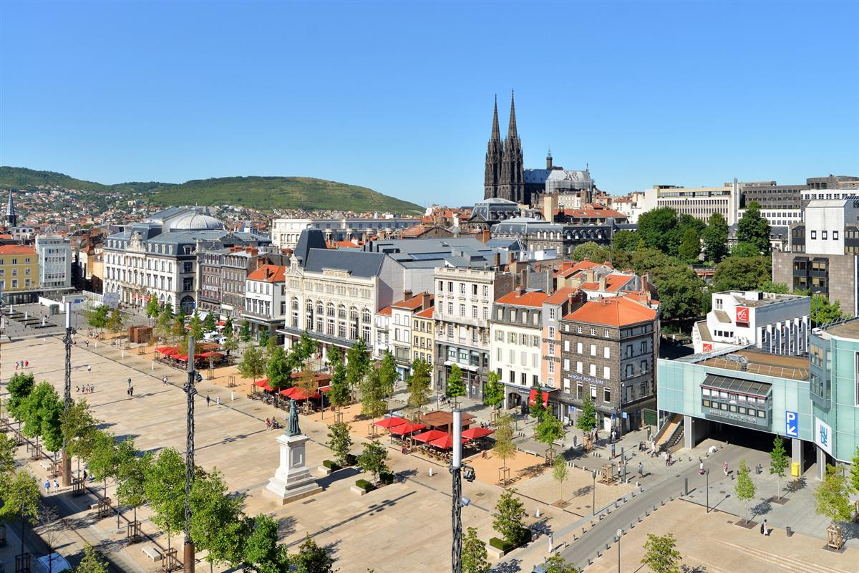
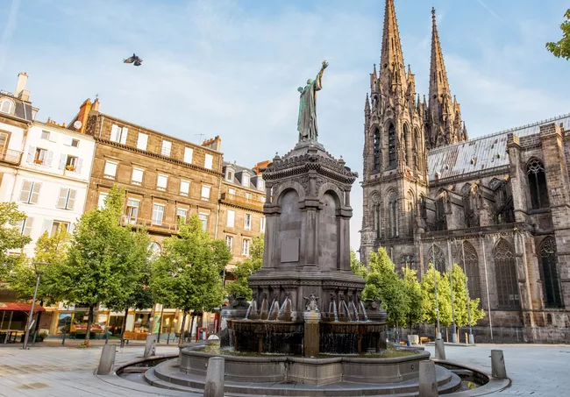

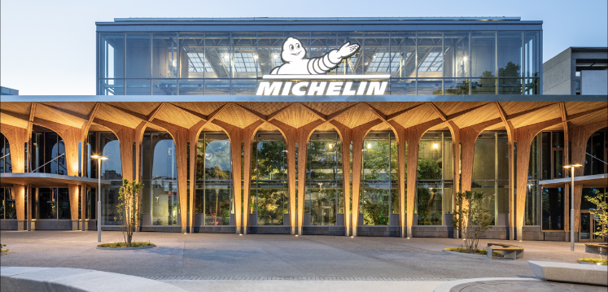
City of Clermont
Population: 300 000 and 42 500 students (about 15%)
Active student population - One of the Leading student cities in France
Easy accessibility (local airport)
Active student population : About 5500 international students
Very affordable cost of living & High quality of life
Dynamic & Culturally Diverse City - Major Cultural Hub
Unique natural region on the UNESCO World Heritage List
Renowned for sports (rugby, soccer, ...)
Michelin Headquarters

Slide 8


Studying in France
Fourth-largest destination for international students and leading non-English speaking destination
Quality education at an affordable budget
Strong benefits for students (social insurance, housing aid, student discounts,…)
Open employment market to international students (possibility of getting a Temporary Resident Permit post graduation for non EU students)
Rich culture, gastronomy, architecture, and vibrant student life, art of living “à la French ”
Courses are professionally oriented and combine theory and practice

Slide 9

Academic Offer
Mainstream Programs
Executive Education and Offshore Programs

Slide 10






ESC Clermont Programs
Bachelor in International Management
Bachelor en Communication Digitale & E-Business
Master in Management
Master of Science
  Business Intelligence & Analytics
  International Commerce & Digital Marketing
  Corporate Finance & Fintech
  Project Management
  Purchasing & Supply Chain Management
  Strategy & Design for the Anthropocene
  Transforming Mobility

Slide 11

ESC Clermont Programs
Mastère Spécialisé
  Gestion des Ressources Humaines et Innovation Managériale
Executive Programs
  Executive Bachelor in Management - Management de Projets Digitaux & Commerciaux
  MBA - Executive Master in Management
Tailor-Made Programs (for companies and/or idividuals)
Certificates
Offshore Programs
  Master in International Business
  Doctorate in Business Admnistration

Slide 12

Bachelor in International
Management Program
Overview of the Program
Access and Admission Requirements

Slide 13
Bachelor in International Management Program
Program designed in collaboration with partner companies
Highly international Program (many students and faculty members from abroad – up to 3 study periods can be spent in a partner institution abroad)
Degree recognised by the French Ministry of Higher Education and accredited by the EFMD
Consistently ranked among the Best Business Bachelors in France
Thorough preparation for entering the job market through valuable work experience
The success rate of the BIM program is one of the highest in France : 93%
Possibility of studying abroad in a partner university during the final year (3rd year)

Slide 14
Access and admission requirements
Entry Requirements…* | Length of studies at ESC Clermont | Language of the program | Prerequisites | Professional experience
Bachelor in International Management – 1st year | 3 years | French with some modules in English or 100% English | High school diploma or equivalent TOEFL 80 or equivalent for the English program B2 level French test for the French program (exceptions possible) | 2-month internship in a company starting in June (in France or abroad)
Bachelor in International Management – 2nd year | 2 yeas | French with some modules in English or 100% English | One year of higher education validated TOEFL 80 or equivalent for the English program B2 level French test for the French program (exceptions possible) | 5-month internship in a company starting in April (in France or abroad)
Bachelor in International Management – 3rd year | 1 year | French with some modules in English or 100% English | Two years of higher education validated TOEFL 80 or equivalent for the English program B2 level French test for the French program (exceptions possible) | Internship in a company possible but not mandatory
* Please check with your home institution to ensure that this access route is included in our partnership agreement

Slide 15

Bachelor in Digital Communication and E-Commerce
Overview of the Progam
Access and Admission Requirements

Slide 16
Bachelor in Digital Communication and E-Commerce
Program taught 100% in French. 3rd year offered in French or English. Possibility of integrating the program in the 3rd year 100% taught in English
Highly professional program covering all aspects of digital marketing and e-commerce
Students will acquire all the technical skills, digital culture and certifications they need to flourish in the digital marketing and e-commerce professions.
Highly international Program (many students and faculty members from abroad – up to 3 study periods can be spent in a partner institution abroad)
Degree recognised by the French Ministry of Higher Education
Thorough preparation for entering the job market through valuable work experience

Slide 17
Access and admission requirements
Entry Requirements * | Length of studies at ESC Clermont | Language of the program | Prerequisites | Professional experience
Bachelor in Digital Communication and E-Commerce – 1st year | 3 years | French | High school diploma or equivalent B2 level French test for the French program (exceptions possible) | 2-month internship in a company starting in June (in France or abroad)
Bachelor in Digital Communication and E-Commerce – 2nd year | 2 yeas | French | One year of higher education validated B2 level French test for the French program (exceptions possible) | 5-month internship in a company starting in April (in France or abroad)
Bachelor in Digital Communication and E-Commerce – 3rd year | 1 year | French or 100% English | Two years of higher education validated TOEFL 80 or equivalent for the English program B2 level French test for the French program (exceptions possible) | Internship in a company possible but not mandatory
* Please check with your home institution to ensure that this access route is included in our partnership agreement

Slide 18

Master in Management
Program
Overview of the Progam
Access and Admission Requirements

Slide 19
Master in Management / Master Grande Ecole Program
Program designed in collaboration with partner companies
Highly international Program (many students and faculty members from abroad)
Degree recognised by the French Ministry of Higher Education and accredited by AMBA
13 majors (including 5 taught in English)
Thorough preparation for entering the job market through valuable work experience
Double-degree possibilities with ESC Clermont MSc programs
Indicators of the professional integration survey:
  81% of graduates found a job in less than two months
  87% of graduates found a job within 6 months

Slide 20
Majors available in the last year
1 major of your choice. Choice to be made during the summer (WARNING: contact your home institution to find out which majors you can select):
(e)Business Development French
Culture Startup et Entrepreneuriat French
Mobility: Business Models and Vehicles for the Future English
Contrôle de Gestion French
Business Intelligence English
Développement RH et Accompagnement des Mobilités French
Digital Design Manager French
Ingénierie Financière et Innovation en Finance French ou English
Retail Management et Marketing Produit French
Sport Business French
Purchasing and Supply Chain Management English
Management des Etablissements Sanitaires et Sociaux French
Digital Marketing et Communication French ou English
Design de la Redirection Ecologique Mix
Finance Durable et Investissement Socialement Responsable Mix
Management des Organisations Responsables French

Slide 21
Access and admission requirements
Entry Requirements* | Length of studies at ESC | Language of the program | Prerequisites | Professional experience | Comments
Pre Master (MGE1) | 3 years | Choice of French or English | Two years of higher education validated TOEFL 80 or equivalent for the English program B2 level French test for the French program (exceptions possible) | 3-month internship in a company starting in June (in France or abroad)
Master in Management / Master Grande Ecole 1st year (MGE2) | 2 years | Choice of French or English | Three years of higher education - Bachelor's degree or equivalent TOEFL 80 or equivalent for the English program B2 level French test for the French program (exceptions possible) | 3-month internship in a company starting in June (in France or abroad) | 3 possible tracks: Classic track 24-month work-study track Audit Expertise Consulting track (French only) (Special conditions for the work-study program and the AEC)
Master in Management / Master Grande Ecole 2nd year (MGE3) | 1 year | Choice of French or English | 4 years of higher education - M1 or equivalent TOEFL 80 or equivalent for the English program B2 level French test for the French program (exceptions possible) | 6-month internship in a company starting in January (in France or abroad) | 2 possible tracks: Classic track 12-month work-study track (Special conditions for the work-study program)
* Please check with your home institution to ensure that this access route is included in our partnership agreement

Slide 22

Master of Science Programs
Overview of the Progams
Access and Admission Requirements

Slide 23
Masters of Science
Taught 100% in English and accredited by the CGE
Two academic semesters + one semester of internship
Specialized expertise in specific fields of activity:
  Business Intelligence & Analytics
  International Commerce & Digital Marketing
  Corporate Finance & Fintech
  Project Management
  Purchasing & Supply Chain Management
  Transforming Mobility
Accelerated and career-oriented programs
A variety of international and professional career paths
Possibility of a Double Degree with the Master in Management

Slide 24
Access and Admission Requirements
Entry Requirements* | Length of studies at ESC | Language of the program | Prerequisites | Professional experience | Comments
Masters of Science 6 Specialized MSc Programs : Business Intelligence & Analytics International Commerce & Digital Marketing Corporate Finance & Fintech Project Management Purchasing & Supply Chain Management Transforming Mobility | 1 year | 100% English | At least 4 years of higher education - M1 or equivalent TOEFL 80 or equivalent for the English program B2 level French test for the French program (exceptions possible) | 4-month internship starting in June (in France or abroad) | Fast-track program including: Two semesters of study a 4-month work experience an internship a professional thesis and a presentation
* Please check with your home institution to ensure that this access route is included in our partnership agreement

Slide 25

Practical Information
Language of Instruction The Work-Study Program | Tuition Fees Application Procedure Visa

Slide 26
Program Languages Available
  Bachelor in International Management : 100% English or French (with some modules in English)
  Master in Management : 100% English / Mix French - English / 100% French
  Master of Science: 100% English
  Conditions to attend courses in English: You must provide an official English test at the time of your application
  Be sure to specify this choice in your application
  Please note that places are limited and that there is no guarantee that all French-speaking students will be able to take courses in English. Groups are formed at the beginning of the academic year.
ENGLISH TEST ACCEPTED FOR THE APPLICATION:
Native Speaker or TOEFL iTP 550, TOEFL iBT 80, IELTS 6.0, TOEIC 790, Duolingo 115, PTE general Level 3, PTE academic 58, ITEP academic 3,9, Cambridge B2 First or C2 Advanced, or equivalent
FRENCH TEST ACCEPTED FOR THE APPLICATION:
TCF B2 or DELF B2
WARNING : To obtain the Master Grande Ecole degree, you must pass the TOEIC test with a minimum score of 790. Possibility to take the TOEIC test at ESC Clermont (1 free test)
No other test will be accepted by the graduation jury.

Slide 27
Work-Study Track
The work-study track is a training system that allows students to alternate periods of theoretical learning at the School and professional immersion in a company.
This system exists in the 3rd year of our Bachelor's program and in the Master Grande Ecole program, during the two years of the Master's program or only in the final year.
In September 2022, it became possible for new students arriving in France to sign a work-study contract. However, at ESC Clermont, we require students to be physically present in the school during the previous year to get access to the expertise and services provided by our Corporate Relations Department.
Students are nevertheless allowed do their own research to find a host company. In this case, the following rules apply :
A mandatory score of B2 in a French language test must be provided for the school to sign a work-study contract. No exceptions are possible)
New students wishing to do a work-study program have until June 30th at the latest to find their company. No exceptions are possible.

Slide 28
Tuition Fees*
Bachelor in International Management : 7900€ per year
Master Grande Ecole : 10 900€ per year
Master of Science: 12 950€
Payment : Deposit of 3500€ to be paid upon receipt of the pre-admission letter
Balance of tuition fees to be paid before December 31st.
The 3500€ deposit will be refunded only in case of visa refusal (minus 250€ administrative fees)
* A partner institution fee-discount may be available. Please contact your home institution’s IRO office for more information.

Slide 29
Application Procedure
Timing | PROCEDURE | PERSON IN CHARGE
April – May | The partner institution pre-selects candidates and sends the finalized list of nominees and email addresses to the ESC Clermont BS before May 31st at the latest. | Home Institution
April – May | The application link (specific link for exchange students) is sent to the nominees by the ESC Clermont. | ESC Clermont BS – International Office
April – May 31 May | Students complete the online application form and upload copies of supporting documents in PDF format (ID or passport/ CV / motivation letter/ high-school graduation certificate or equivalent/grade transcripts/ language-level certificate) Final Application Deadline | The Applicant - Student
June / July | The applications are examined by the ESC Clermont BS. If the application is complete and the student is accepted, he/she will then receive a pre-admission letter from the ESC. | ESC Clermont BS – International Office
June / July | The applicant either accepts or declines the admission offer. He/she must confirm admission by payment of the 3500-euro fee-deposit (to be deducted from the outstanding tuition fee for the coming year.) | The Applicant - Student
June / July | The ESC Clermont BS sends the official admission letter, which is necessary for the visa application | ESC Clermont BS – International Office
June / July | Visa application procedure : The student applies for a student visa via Campus France. The application will be followed by an interview with the French Consular Services. The French Embassy will then either approve or reject the student visa request. | The Student
June / July | Students who have confirmed their admission are required to complete an online registration procedure with the ESC Clermont Administrative Service** (procedure for degree-seeking students only) The programme office will also contact future students about their choice of specialization course(s). | Administrative Service of the ESC Clermont BS & Programmes Office
End of August / September | The student arrives in France – Orientation and start of classes. | The Student / ESC Clermont BS
17/10/2024
29
** Compulsory Registration Procedure to obtain a student account and get access the school’s digital resources.

Slide 30
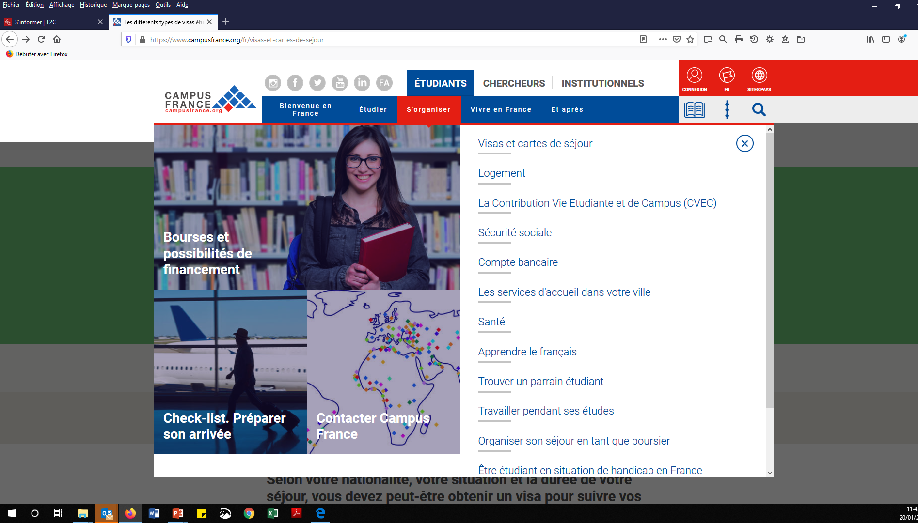
Visa Application
Visa Application : Campus France
You should apply at least 2-months before your intended departure date
Fast-track application procedure for students participating in an exchange programme. However, the sanitary crisis could cause delays.
Validate your visa when you arrive in France
Simplified online validation procedure as soon as you have to have a permanent address in France. Required documents : Passport & Visa, Bank Card

Slide 31
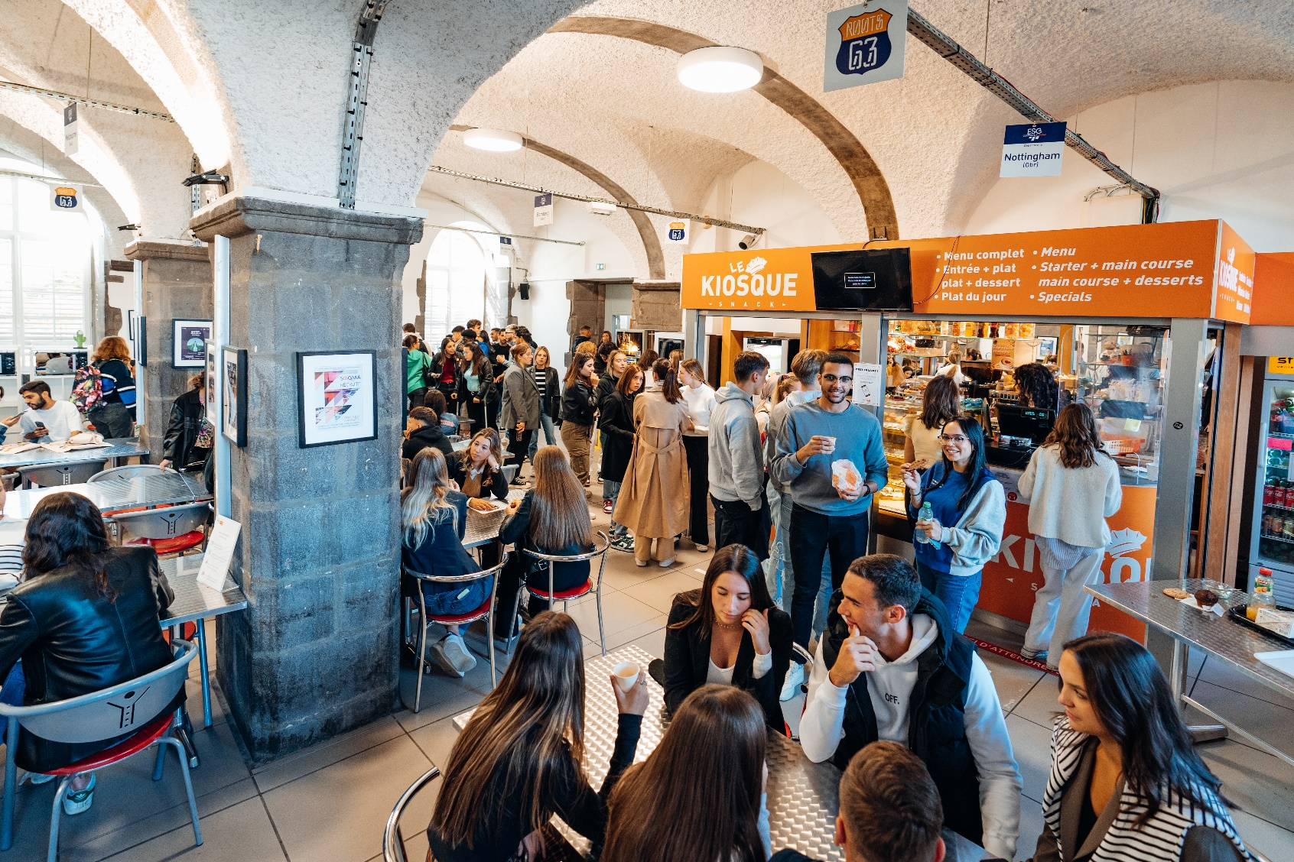
Integration
Cost of Living
Accommodation
Contacts

Slide 32
Cost of Living in Clermont-Ferrand
Daily expenses including rent, food, or other bills are estimated to be around 700€ per month – This amount does not include tuition fees
The first month, students will have additional expenses (rent deposit, electricity, gas, telephone,...)
Students must pay the CVEC - Contribution Vie Étudiante et de Campus (100€/year)
 | MINIMUM
Rent for furnished room / furnished studio apartment (all charges included) | 400 €
Meals (breakfast, lunch & dinner) | 200 €
Outings | 30 €
Communication | 30 €
Transport / travel | 40 €
TOTAL | 700 €

Slide 33

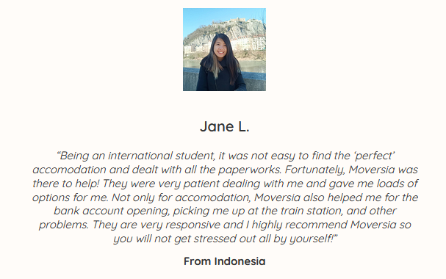
Accommodation
Partnerships with the School :
Moversia: The ESC’s partner housing agent for international students. The agency provides a made-to-measure pre-arrival housing search based on your criteria as well as an administrative support service on arrival (Fee-paying service). Please contact the agency at least 1-2 months before your planned arrival.
https://welcomeclermont.com/international-students/
The School has partnerships with several student residences in the city: List available in the guide for international students
Several classified ad sites (the best known: Leboncoin.fr) – be wary of scams.
WARNING: To rent an apartment you must have a guarantor in France (some landlords may accept guarantors abroad). You could also suggest paying several months' rent in advance or apply for either the “Visale“ or "Garantme" guarantee service.

Slide 34
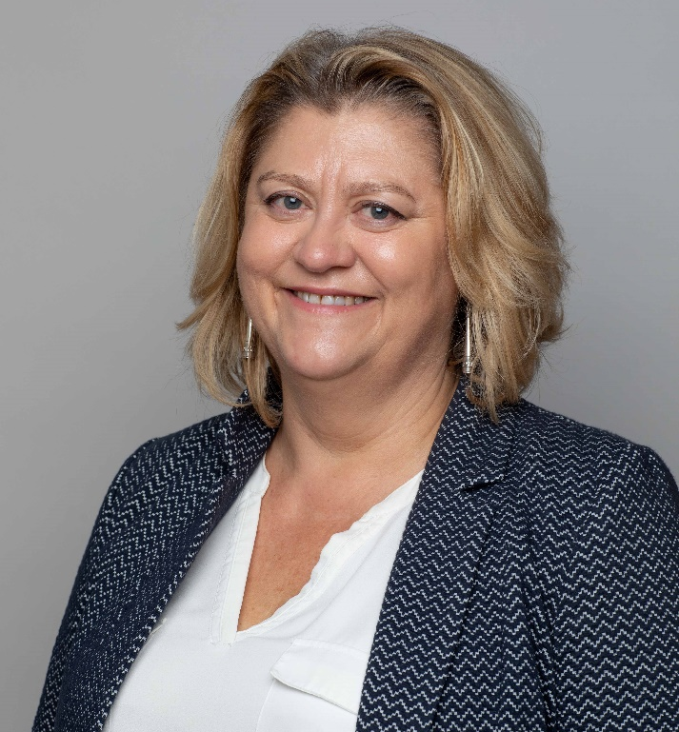
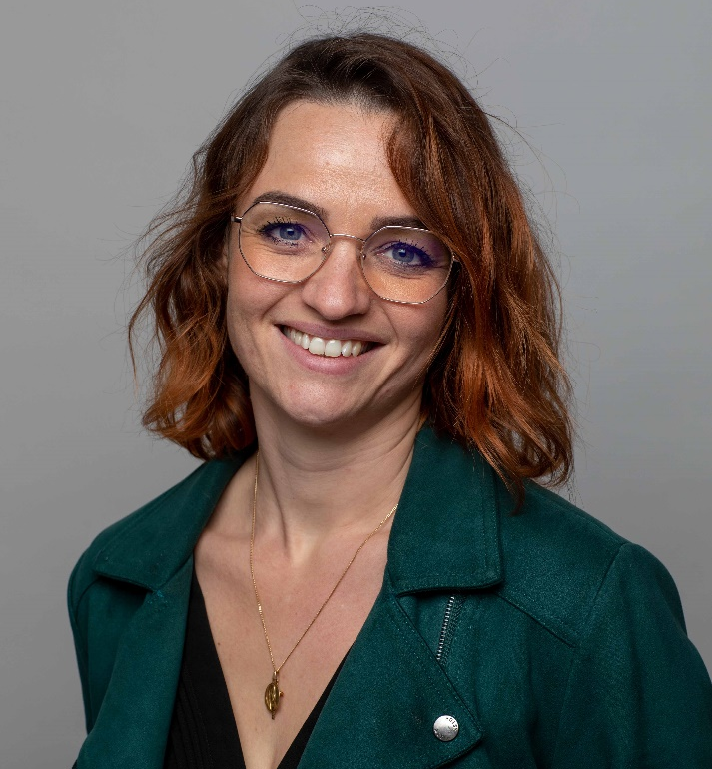
Your contacts
Lisa FIACRE
Head of International Students
Lisa.fiacre@esc-clermont.fr
Audrey ESTEVES
Head of International Relations
Audrey.esteves@esc-clermont.fr

